Slide 1
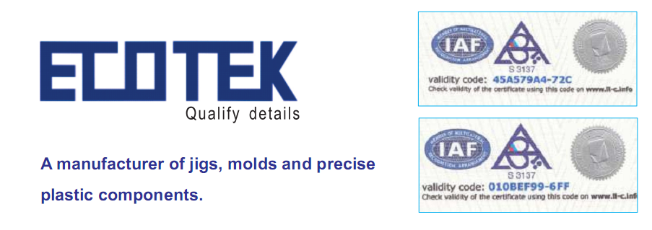
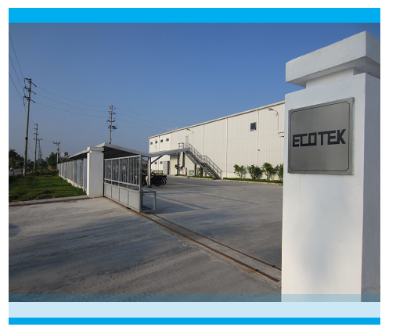
ECOTEK Co.,Ltd. www.eco-tek.vn Lot ІІІ.4.1 ,Thuan Thanh 3 Industrial Zone, Thanh Khuong, Thuan Thanh, Bac Ninh Tel :84-241-3798889 Fax : 84-241-3798890 Email: hai-bui@eco-tek.vn

Slide 2
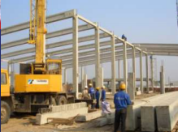
Overview
1) Established : 20/10/2011
2) Started Form : 12/2013
3) Capital
4,500,000 USD
4)Annual Turnover
2,000,000 USD
5) Employees
146 Persons
6) Area
Site : 6.288 ㎡ / Building : 5.426㎡
7) Address
Lot ІІІ.4.1 ,Thuan Thanh 3 Industrial Zone, Thanh Khuong, Thuan Thanh, Bac Ninh, Viet Nam

Slide 3
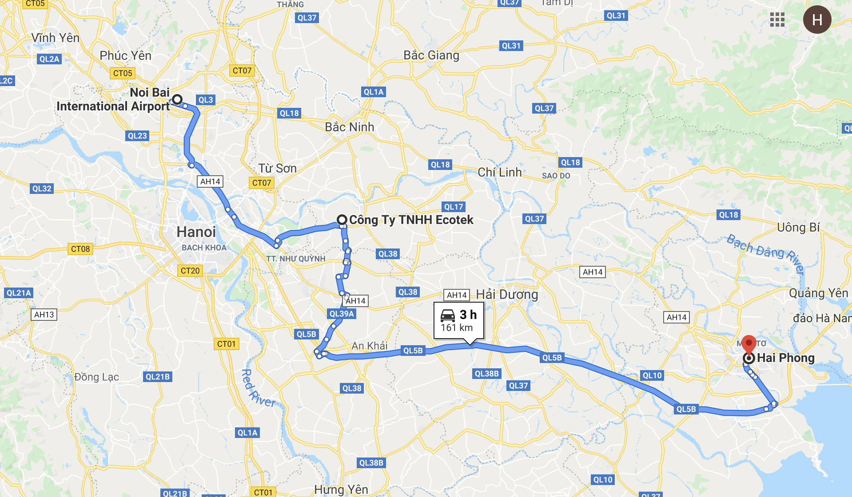
Location

Slide 4
Organization
BOD
QA, ISO MANAGER
FACTORY MANAGER
ADM-HR
QC
INJECTION
MOLD
TUBE
23
10
64
24
19
TOTAL: 142-146 (4 Maternity leaves)

Slide 5
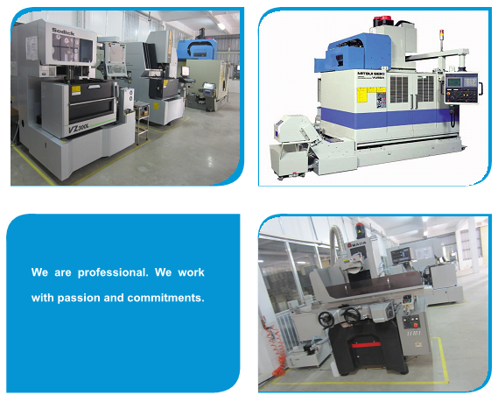
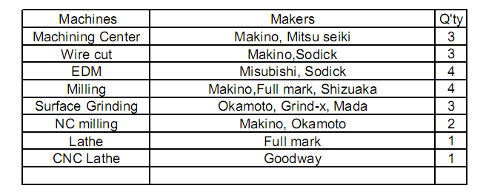
JIG & MOLD PRODUCTION

Slide 6
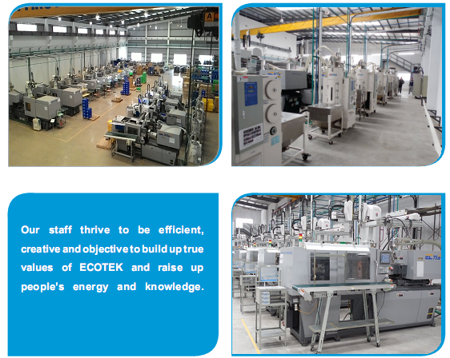
INJECTION PRODUCTION
TOSHIBA INJECTION MACHINES:
50 tons – 75 tons – 100 tons – 230 tons – 350 tons
6 3 7 4 1 = 21 mcs

Slide 7
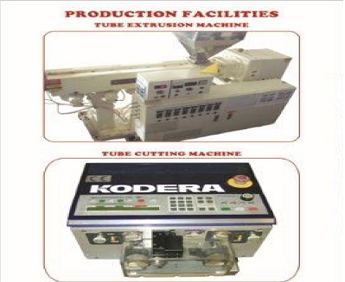
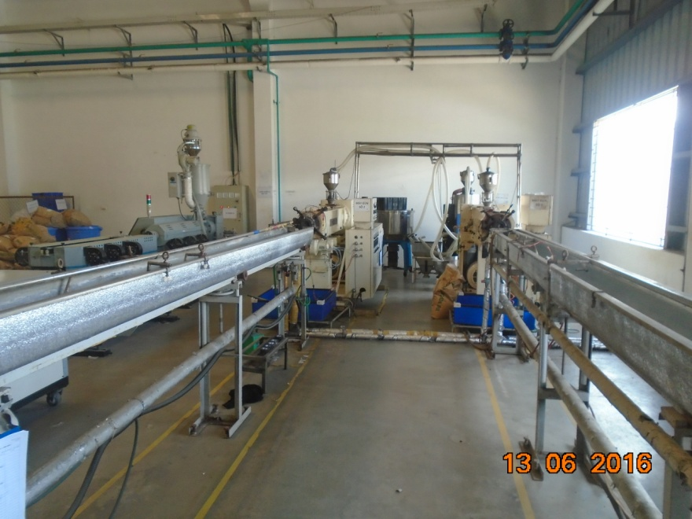
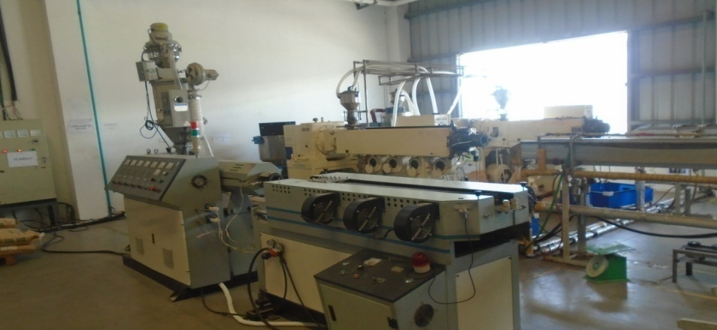
TUBE PRODUCTION

Slide 8
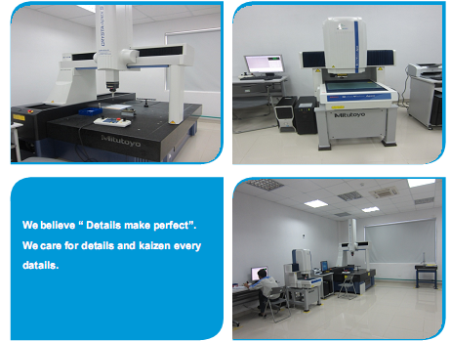
QUALITY ASSURANCE

Slide 9
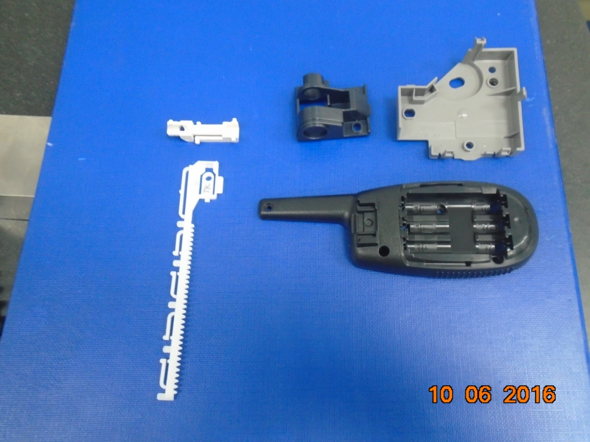
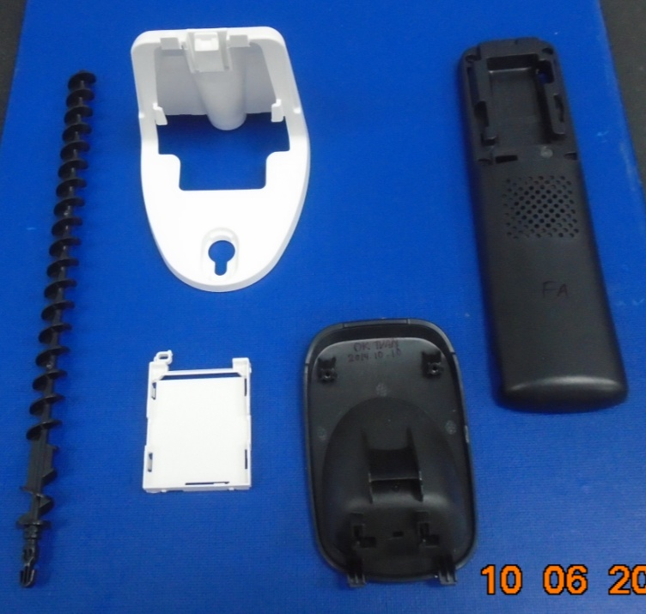
Main Products

Slide 10
Main Products

Slide 11
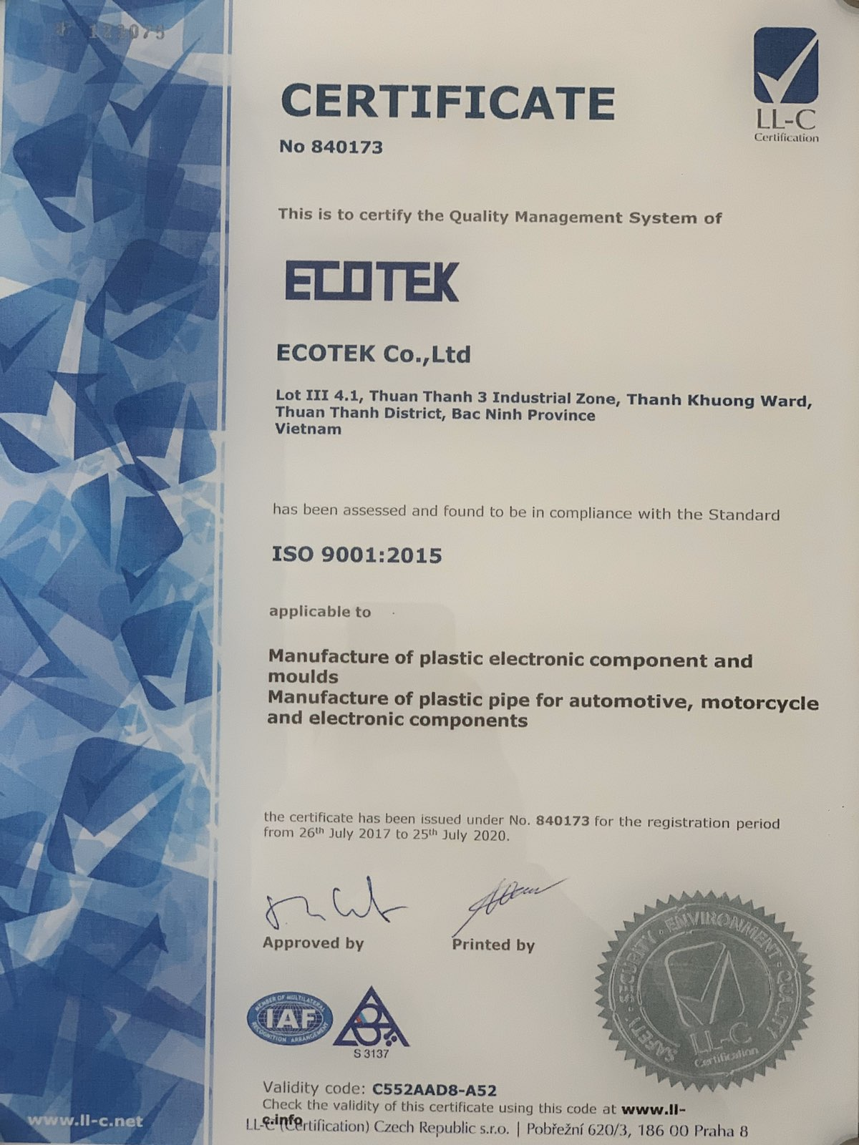
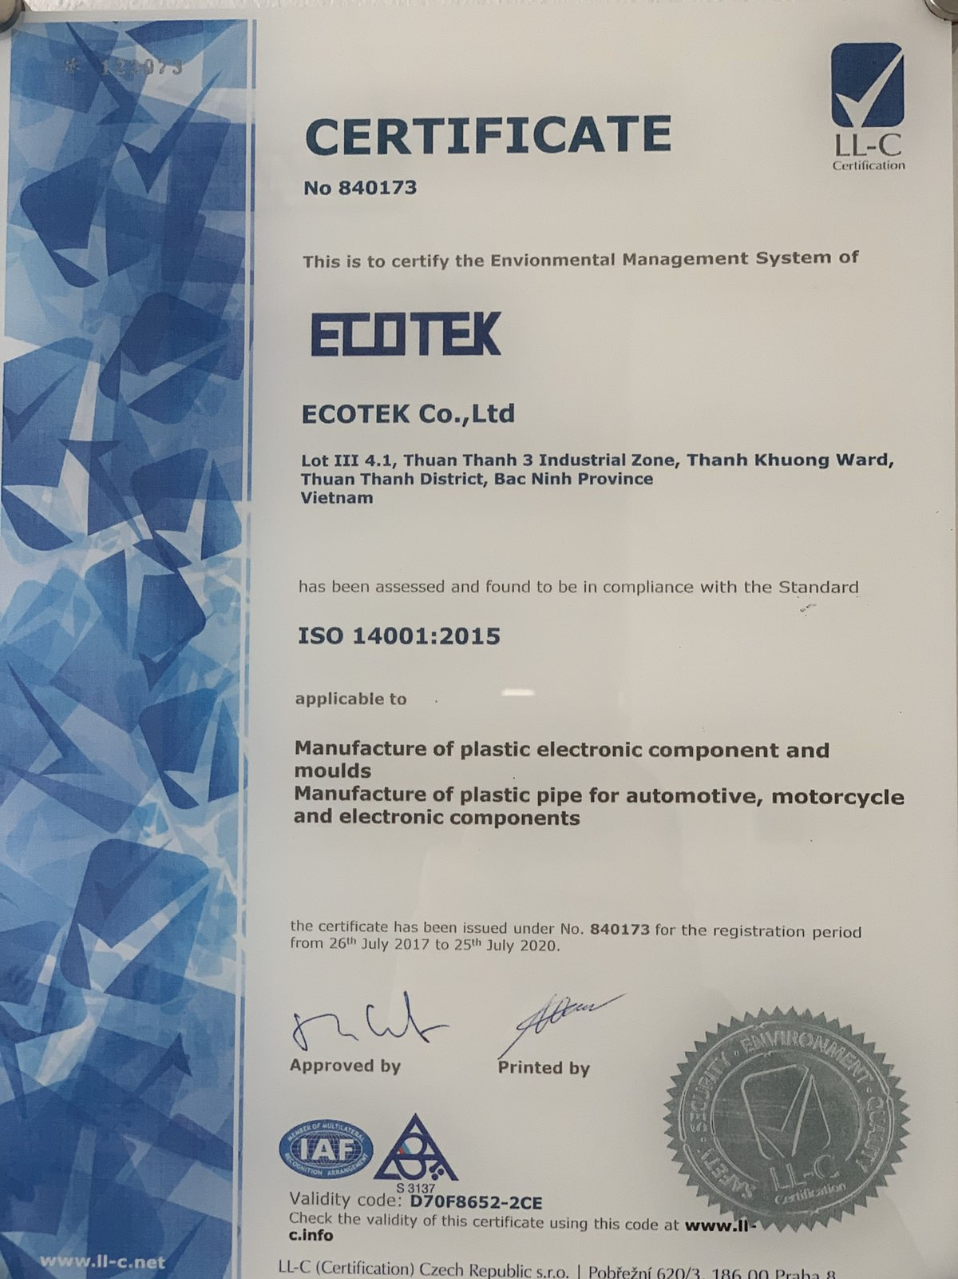
ISO 9001:2015 & ISO 14001:2015

Slide 12
Thank You

